Slide 1

Navigation in Jetpack Compose

Slide 2
Navigation in Android
1
Intent Activity based navigation.
2
Fragment Manager, fragment transactions. Fragment based navigation
3
Navigation framework. Fragment based navigation (NavGraph, NavHostfragment & NavController)
4
Compose Navigation Single Activity – Compose only based navigation

Slide 3
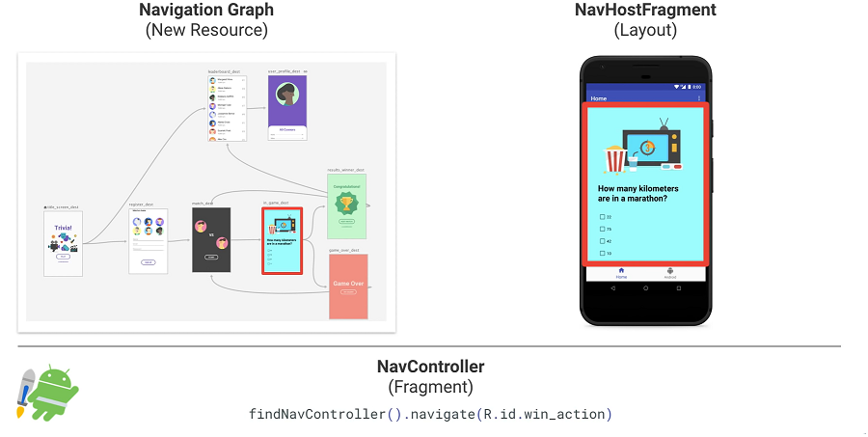
Navigation framework vs Compose navigation
NavGraph
NavHost
Composable destinations
NavController
NavController.navigate(route)

Slide 4
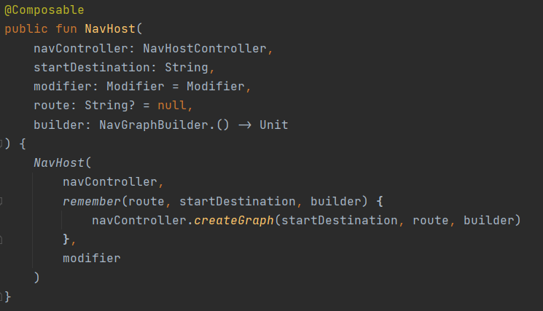
NavHost
NavHost composable
is responsible for hosting the content of the NavDestination associated with the NavBackStackEntry
Links NavController with NavGraph

Slide 5
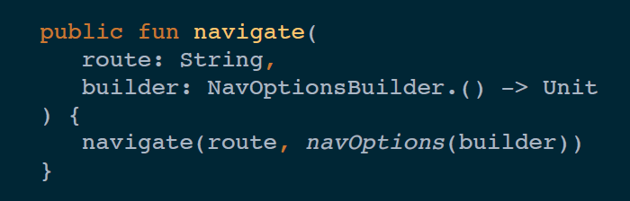
NavController
Central component
Stateful
Keeps track of composable back stack
Provides API to navigate to different composable destinations
navigate
Try to find destination in the graph
Back stack modification based on NavOptions
Add a new/existing NavBackStackEntry to the back stack
Update back stack lifecycle

Slide 6
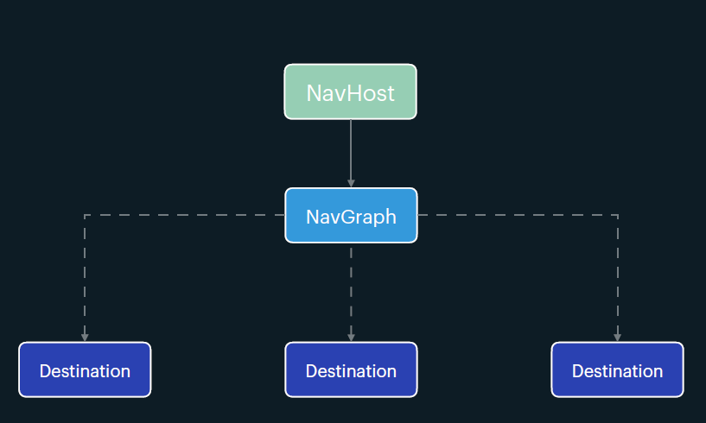
NavGraph
NavGraphBuilder
Constructs and declare composable destinations and nested navigation graph

Slide 7
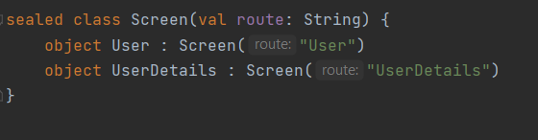
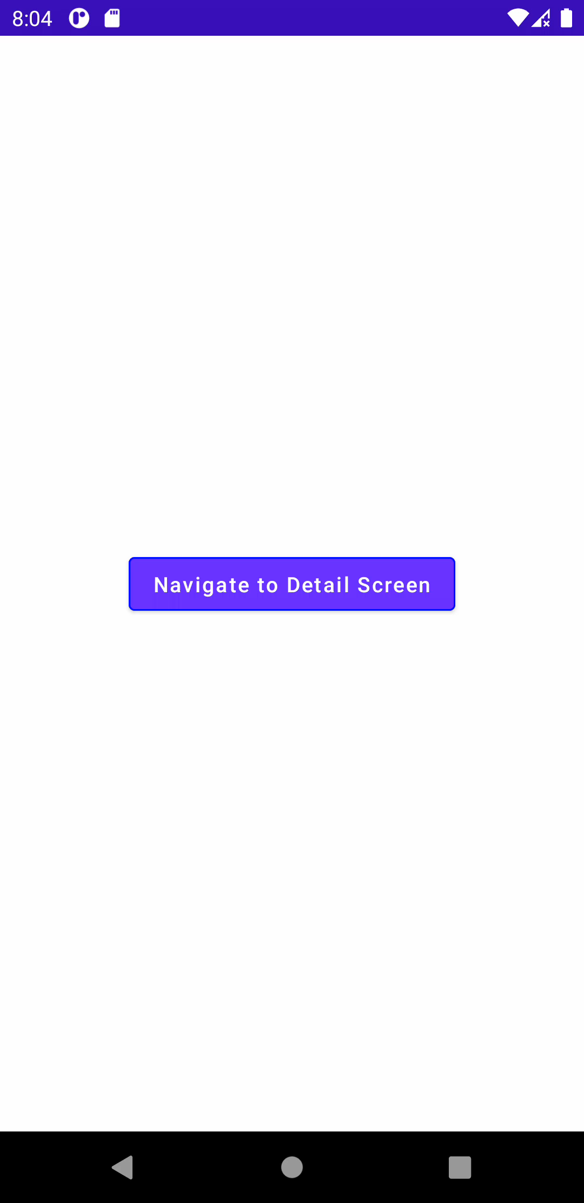
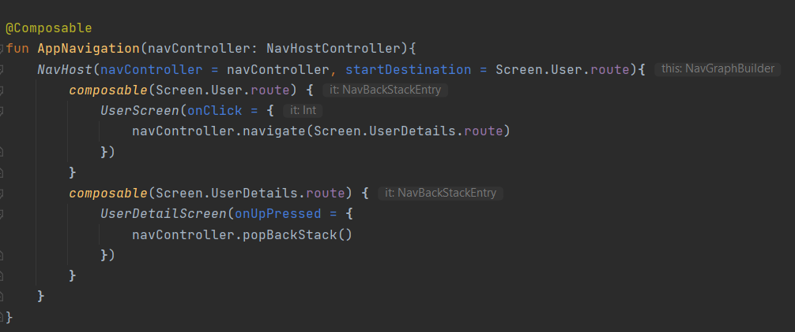
Navigate to a composable
1
Define sealed class to represent composable destinations with route
2
Create navController
User
Detail
3
Link navController and nav graph with NavHost
navController.navigate(“User”)

Slide 8
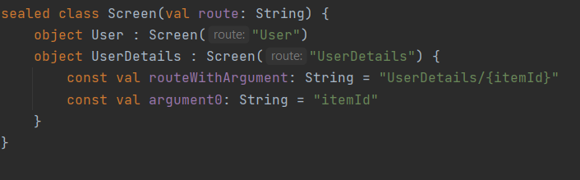
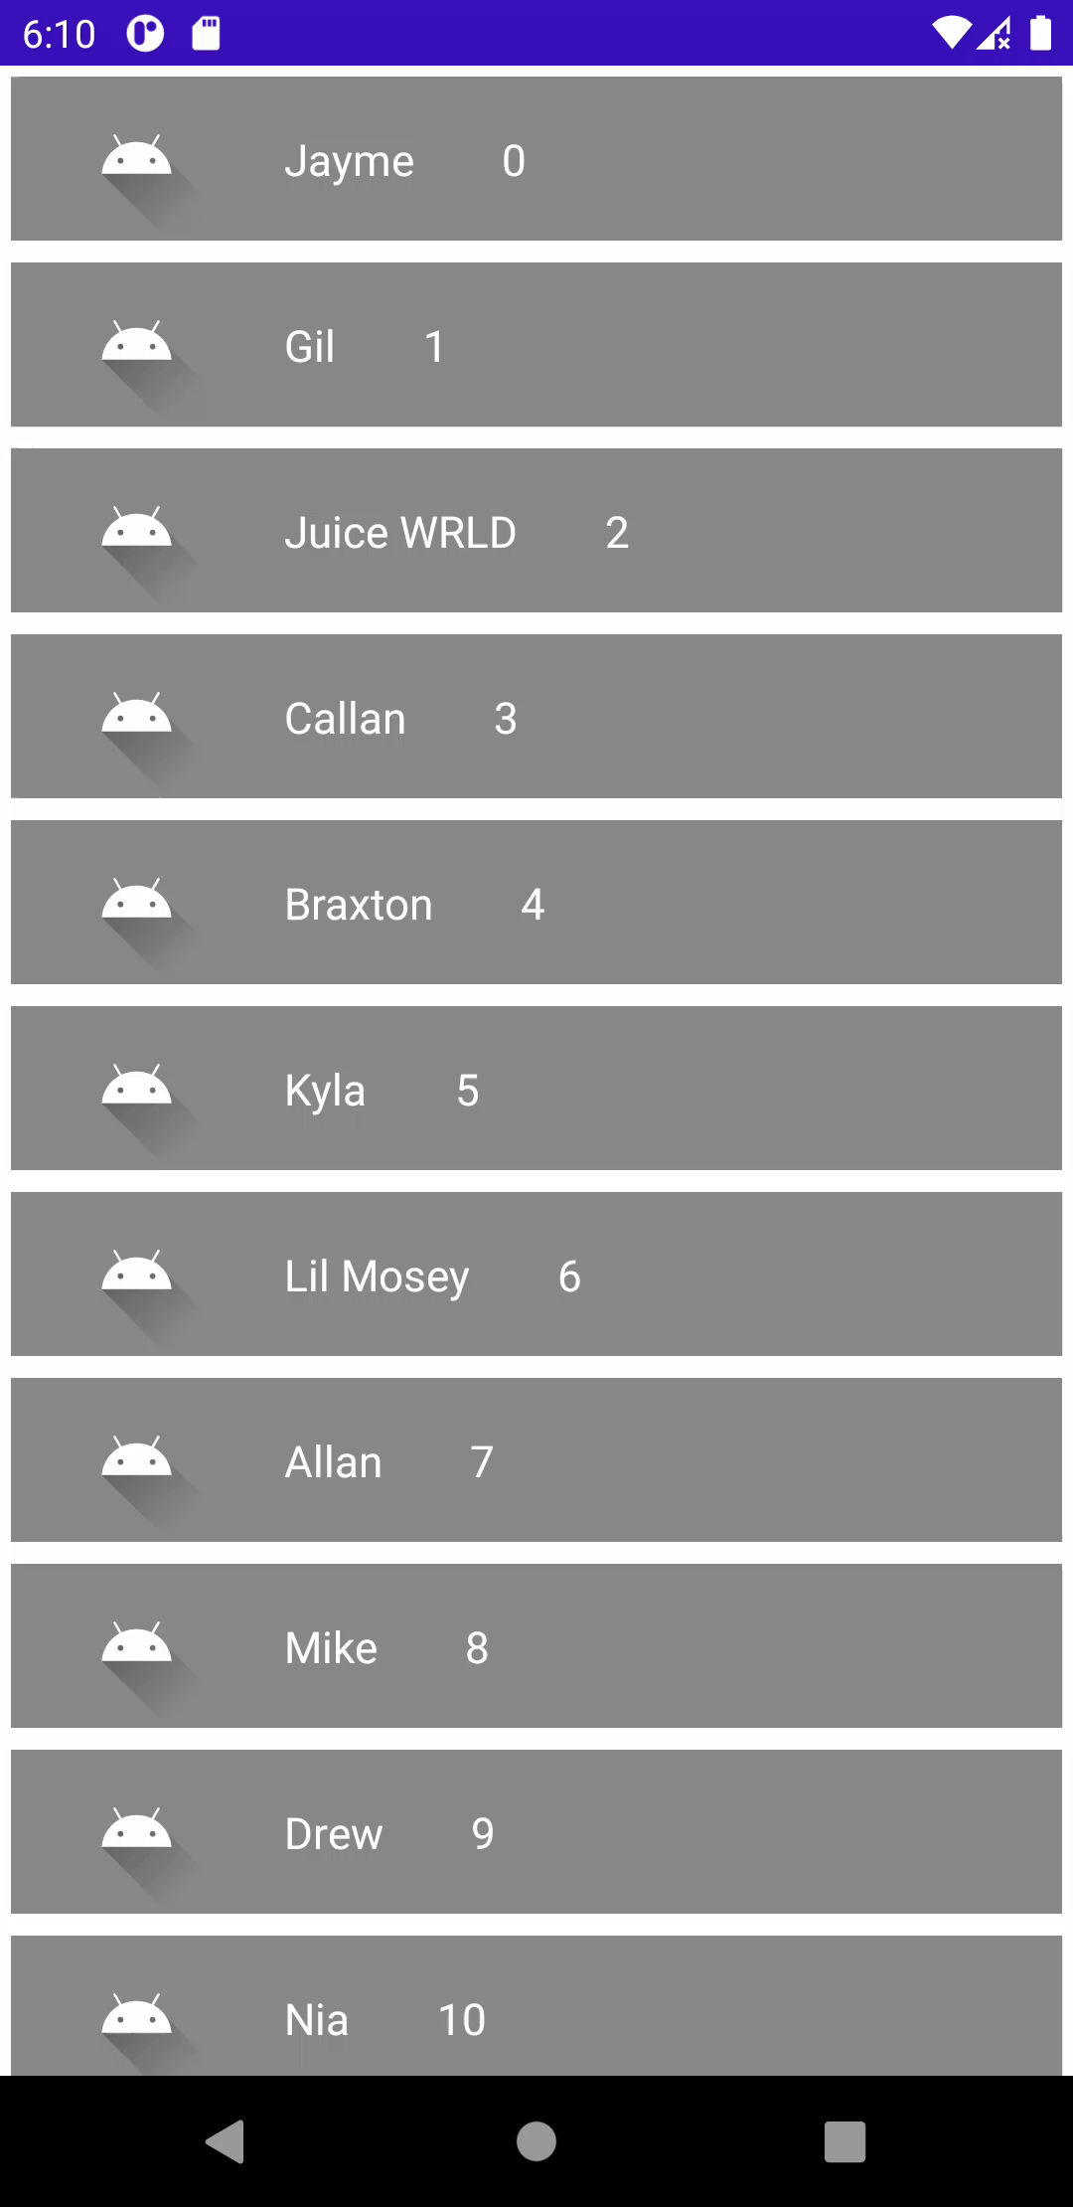
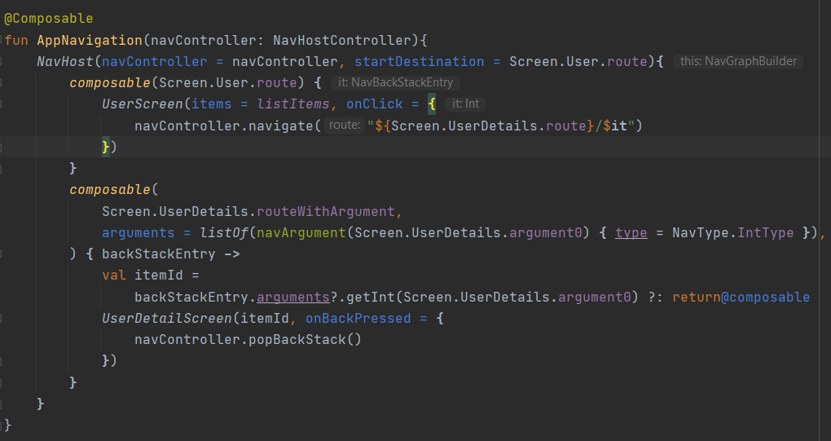
Passing arguments
1
Add argument placeholder to the route
2
Set type of argument & extract NavArguments from NavBackStackEntry

Slide 9
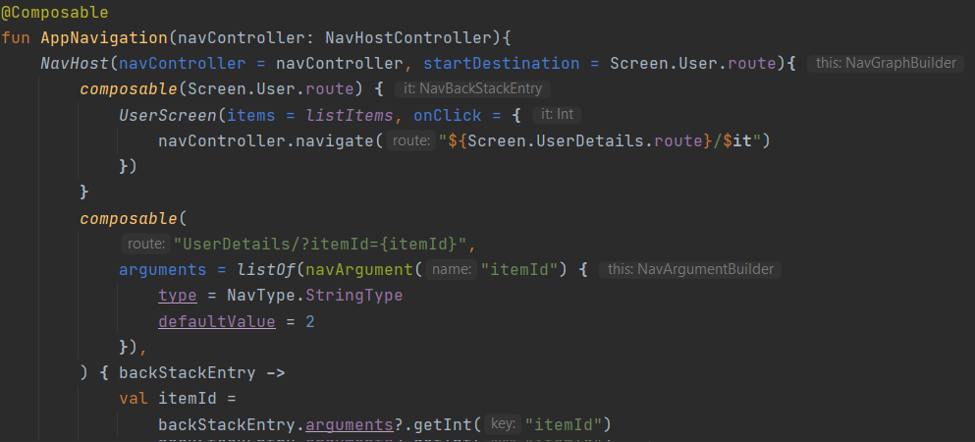
Passing arguments
Optional arguments
query parameter syntax ("?argName={argName}")
Must have defaultValue set or nullability to true,
Supported data types
Integer
Float
Long
Boolean
String
Resource Reference
Parcelable
Serializable
Enum

Slide 10
NavHost
Deep link

Slide 11
NavHost
Nested navigation

Slide 12
NavHost
Inter operability

Slide 13
NavHost
Principles of navigation

Slide 14
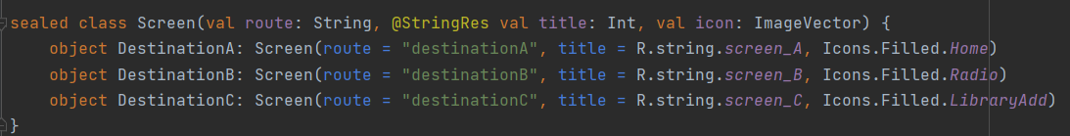
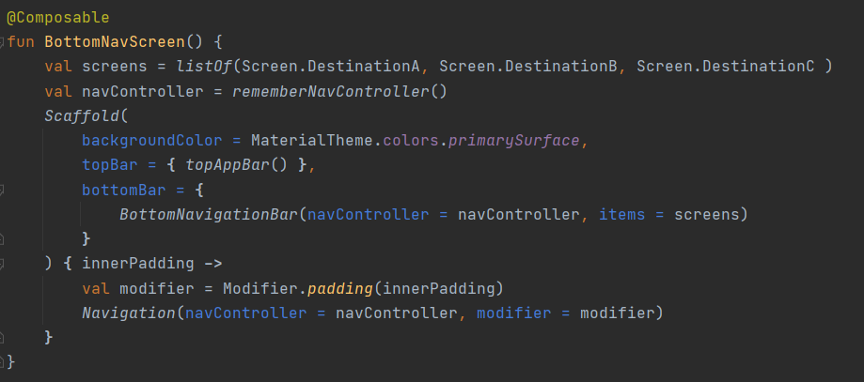
Bottom Navigation
To link to items in BottomNav bar with routes in app.
1
Define sealed class
2
Create list of screen items

Slide 15
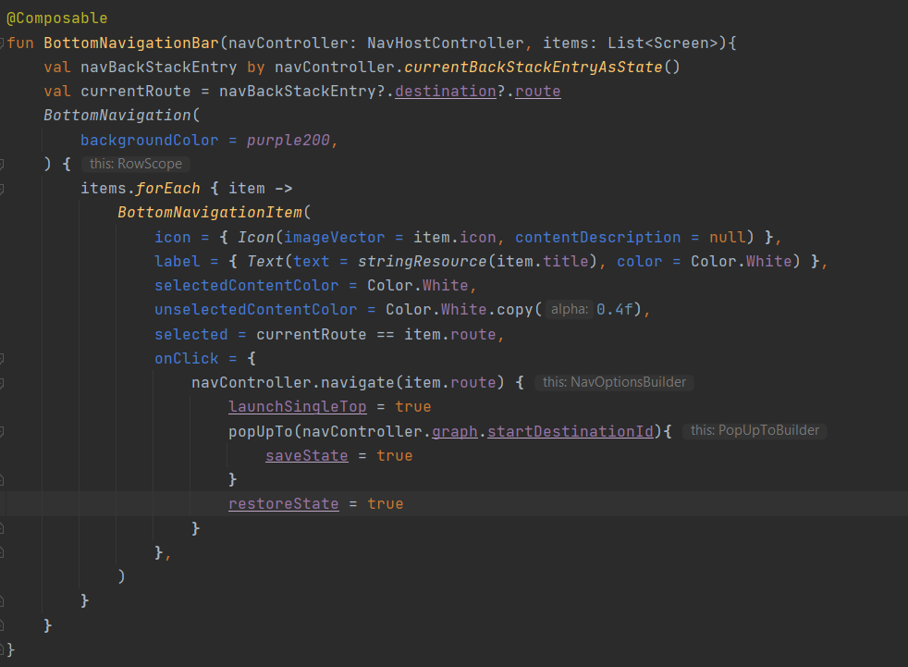
Bottom Navigation
To link to items in BottomNav bar with routes in app.
3
Define BottomNavigation composable

Slide 16
Navigation and Back Stack
StartDestination
A
B
C
1
2
A
C
B
3
A
navigate

Slide 17
Navigation and Back Stack
A
B
C
C
B
A
navigate(“A”) { popUpTo(“A”) }
A
A

Slide 18
Navigation and Back Stack
StartDestination
A
B
C
1
2
C
C
3
B
B
A
A
navigate(“A”) popUpTo(“A”) { inclusive = true }
A

Slide 19
Missing pieces
1
Passing custom objects as arguments using Parcelable.
2
Navigation graph visual editor navigation Editor.
3
Navigation animation are not officially part of navigation compose, although they can be achieved via Google accompanist

